Slide 1
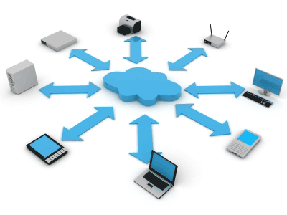
www.SeminarSlide.com
Seminar
On
Grid Computing

Slide 2
Content
Introduction
What is Grid Computing
Who can use Grid Computing
Application
How Grid Computing Works
Architecture

Slide 3
Content
Grid Security Model
Types of Grid
Advantages
Disadvantages
Conclusion

Slide 4
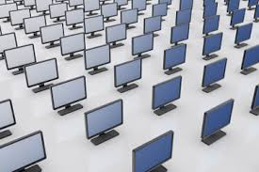
Introduction
Since its introduction, the concept of grid computing has acquired great popularity, even greater than the Web itself had at its beginning.
The concept has not only found its place within numerous science projects (in medicine e.g.), but is also being used for various commercial applications.

Slide 5
What is Grid Computing?
Grid computing is a type of data management and computer infrastructure, designed as a support primarily for scientific research, but, as said in the introduction, also used in various commercial concepts, business research, entertainment and finally by governments of different countries.

Slide 6
Who can use grid computing
Governments and International Organizations
The military
Teachers and educators
Businesses

Slide 7
Grid Computing Applications
One of the most tantalizing applications of radio astronomy is the observation of radio signals as part of Searches for Extra Terrestrial Intelligence (SETI).
The vast amount of computing capacity required for SETI radio signal processing has led to a unique grid computing concept that has now been expanded to many applications.

Slide 8
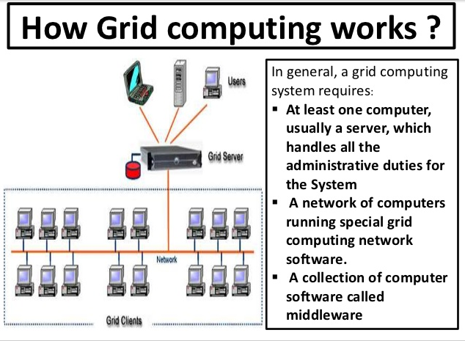

Slide 9
Grid architecture
Fabric layer: Provides the resources to which shared access is mediated by Grid protocols.
Connectivity layer: Defines the core communication and authentication protocols required for grid-specific network functions.
Resource layer: Defines protocols, APIs, and SDKs for secure negotiations, initiation, monitoring control, accounting and payment of sharing operations on individual resources.
Collective Layer: Contains protocols and services that capture interactions among a collection of resources.
Application Layer: These are user applications that operate within VO environment.

Slide 10
Grid Security Model

Slide 11

TYPES OF GRID
Computational Grid
Scavenging Grid
Data Grid

Slide 12
Computational Grid
A computational grid is focused on setting aside resources specifically for computing power.
In this type of grid, most of the machines
are high-performance servers.

Slide 13
Scavenging Grid
A scavenging grid is most commonly used with large numbers of desktop machines.
Machines are scavenged for available CPU cycles and other resources.
Owners of the desktop machines are usually given control over when their resources are available to participate in the grid.

Slide 14
Data Grid
A data grid is responsible for housing and
providing access to data across multiple
organizations.
Users are not concerned with where this data is located as long as they have access to the data.

Slide 15
Advantages
Increased user productivity: By providing transparent access to resources, work can be completed more quickly.
Scalability: Grids can grow seamlessly over time, allowing many thousands of processors to be integrated into one cluster.
Flexibility: Grid computing provides computing power where it is needed most, helping to better meet dynamically changing work loads.

Slide 16
Disadvantages
1) for memory hungry applications that can't take advantage of MPI you may be forced to run on a large SMP. 2) you may need to have a fast interconnect between compute resources (gigabit ethernet at a minimum). Infobahn for MPI intense applications.
3) some applications may need to be tweaked to take full advantage of the new model.

Slide 17
Disadvantages…
4) Licensing across many servers may make it prohibitive for some apps. Vendors are starting to be more flexible with environment like this.
Areas that already are taking good advantage of grid computing include bioinformatics, cheminformatics, and oil & drilling, and financial applications.

Slide 18
CONCLUSION
Grid computing introduces a new concept to IT infrastructures because it supports distributed computing over a network of heterogeneous resources and is enabled by open standards.

Slide 19
Thanks….!!!!
Any question……..??????

